Slide 1
Network Structure and Pricing in the FX Market
Joel Hasbrouck and Richard M. Levich
NYU Stern; NYU Stern and NBER
Notes:
1

Slide 2
Disclaimers
This study is unfunded.
The data are provided by CLS Bank and are commercially available only in aggregated form.
One of us (Hasbrouck) taught in the training program of a firm whose activities include FX trading.

Slide 3
The elevator pitch
Over-the-counter financial markets are often modeled as networks.
An agent’s trading costs are sensitive to the agent’s centrality (“importance”) in the network.
Do more central intermediaries extract a premium in their trades?
Or does competition force them to offer a discount?
Most extant results are mixed and come from smaller US OTC markets.
We examine the currency (foreign exchange, FX) market.
We find a premium.

Slide 4
Search models of over-the-counter markets
Decentralized (over-the-counter, OTC) markets dominate trading in bonds, foreign exchange (FX), swaps, and so forth.
AKA dealer, quote-driven, or two-tier markets
Contrast with centralized (“exchange”) markets.
Holden, Lu, Lugovskyy, and Puzzello, What is the impact of introducing a parallel OTC market? JFE, forthcoming.
Loosely segmented as dealer-to-customer and dealer-to-dealer (interdealer).
Duffie, Garleaunu, Pedersen (2005): random search in the dealer-to-customer segment.
Search intensity is inversely related to the dealers’ bid-ask spreads.

Slide 5
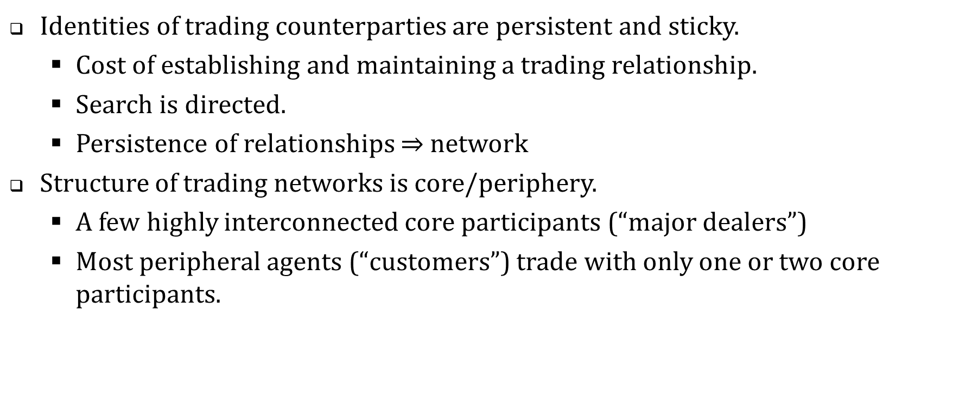
Realities of most OTC markets depart from random search.
Identities of trading counterparties are persistent and sticky.
Cost of establishing and maintaining a trading relationship.
Search is directed.
Persistence of relationships $⇒$ network
Structure of trading networks is core/periphery.
A few highly interconnected core participants (“major dealers”)
Most peripheral agents (“customers”) trade with only one or two core participants.

Slide 6
A network is defined by nodes and edges
Nodes: trading agents
An edge is imputed between nodes i and j if the pair does at least one trade over a sample month.
Edges are undirected (not signed).
In base-case analyses, edges are unweighted.
Alternatively: weight by number or value of exchanges.

Slide 7
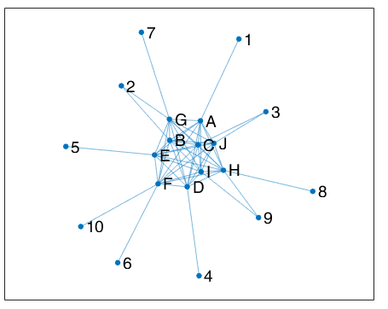
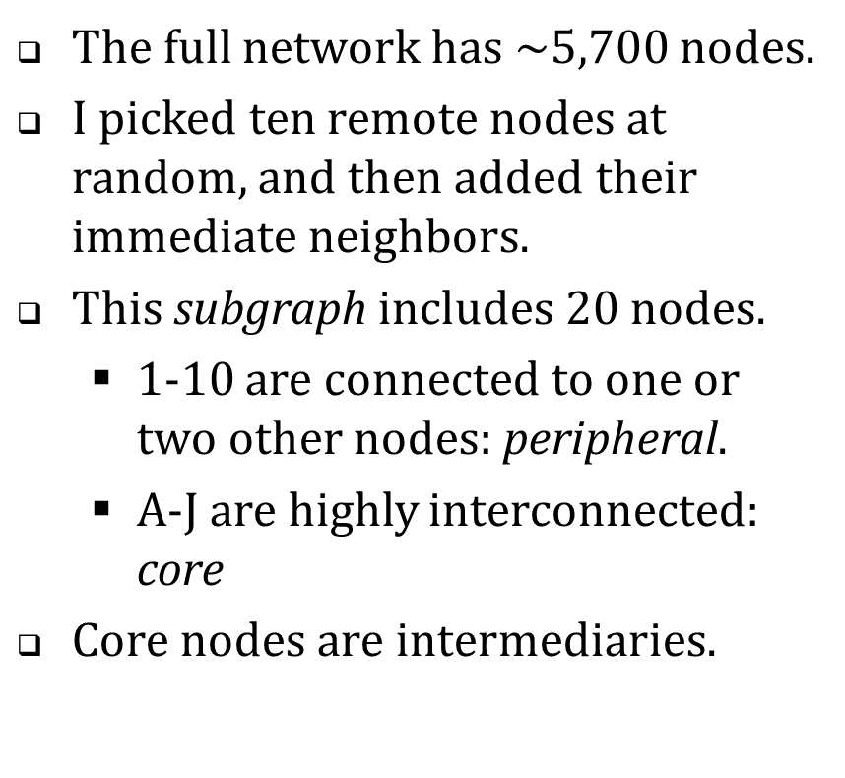
Example: A subgraph of the EUR/USD network (April 2016)
The full network has $\sim 5,700$ nodes.
I picked ten remote nodes at random, and then added their immediate neighbors.
This subgraph includes 20 nodes.
1-10 are connected to one or two other nodes: peripheral.
A-J are highly interconnected: core
Core nodes are intermediaries.

Slide 8
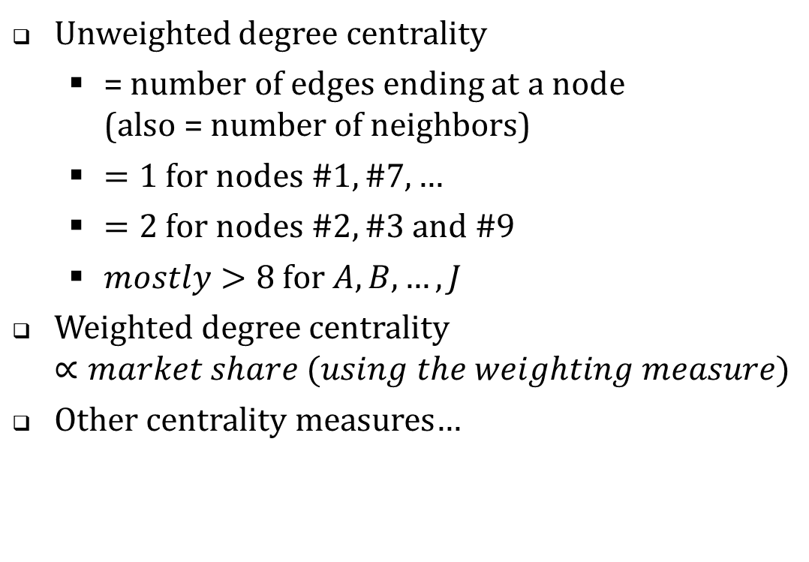
Node centrality (“importance”)
Unweighted degree centrality
= number of edges ending at a node (also = number of neighbors)
$=1 for nodes \#1, \#7, …$
$=2 for nodes \#2, \#3 and \#9$
$mostly>8 for A, B, …, J$
Weighted degree centrality $∝market share (using the weighting measure)$
Other centrality measures…

Slide 9
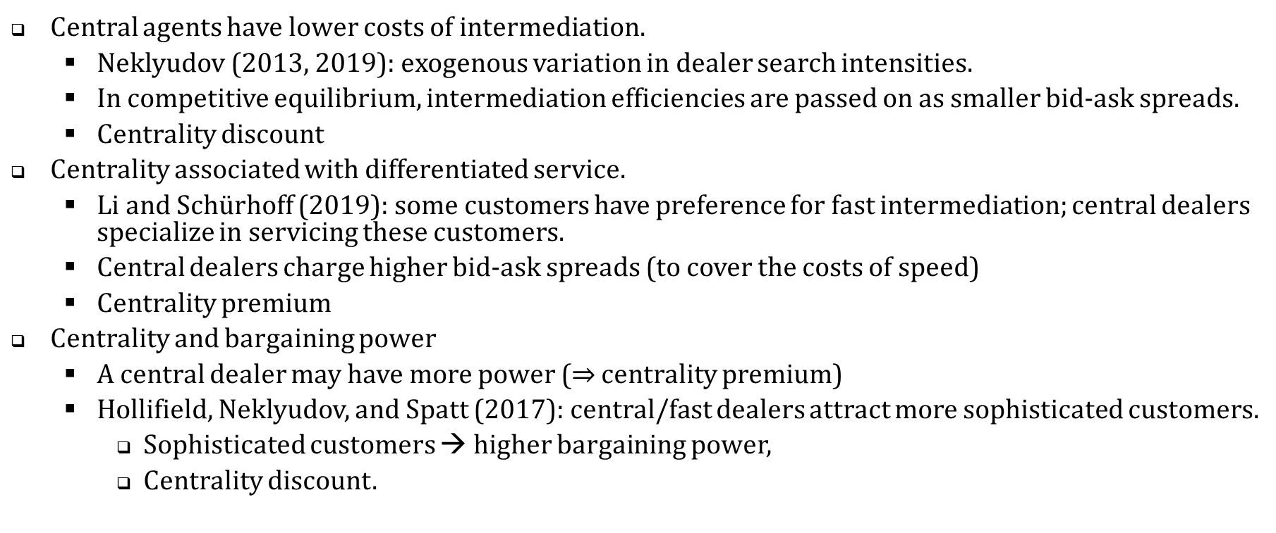
Network position and trading costs: the economic themes
Central agents have lower costs of intermediation.
Neklyudov (2013, 2019): exogenous variation in dealer search intensities.
In competitive equilibrium, intermediation efficiencies are passed on as smaller bid-ask spreads.
Centrality discount
Centrality associated with differentiated service.
Li and Schürhoff (2019): some customers have preference for fast intermediation; central dealers specialize in servicing these customers.
Central dealers charge higher bid-ask spreads (to cover the costs of speed)
Centrality premium
Centrality and bargaining power
A central dealer may have more power ($⇒$ centrality premium)
Hollifield, Neklyudov, and Spatt (2017): central/fast dealers attract more sophisticated customers.
Sophisticated customers → higher bargaining power,
Centrality discount.

Slide 10
Centrality premium or discount? The existing evidence
Centrality premium
Li and Schurhoff (2019). US Municipal bonds.
Di Maggio, Kermani and Song (2017). US Corporate Bonds.
Gabrieli and Georg (2017). European overnight lending
Centrality discount
Hollifield, Neklyudov and Spatt (2017). US Securitizations.
Julliard, Liu, Seyedan, Todorov and Yuan (2019). UK repos/reverse repos.
More central banks pay lower haircuts (in repos). Premium
More central banks charge lower haircuts (in reverse repos). Discount

Slide 11
Foreign Exchange (FX) market is larger
Pre-existing studies
Hagströmer and Menkveld (2019): “empirical support for [a centrality premium] is weak, at best.”
One currency pair (CHF/EUR), eight dealers; three-week sample.
Centrality premium or discount?
Our study: premium, definitely
Does the premium reflect a cost? Probably
Questions?

Slide 12
The FX market, settlement, and the CLS Bank
Companion paper: FX Liquidity and Market Metrics: New Results Using CLS Bank Settlement Data, Hasbrouck and Levich

Slide 13
FX market: “traditional view”
Sharp segmentation between …
Customers: small banks, non-financial firms, investment funds, retail
Dealers: large banks
Customers only trade with (a small number of) dealers.
The only market that matters is the interdealer market:
The interdealer market dominates price (exchange rate) determination and liquidity.
Customers are frozen out of the interdealer market.
Notes:
Over-the-counter, quote-driven, or dealer market

Slide 14
FX market: current view
Customer/dealer segmentation is blurred.
Multilateral trading systems allow customers to contact multiple dealers.
Request for quote (RFQ) protocols.
Prime brokerage allows large customers access to interdealer trading platforms.
Widespread use of algorithmic trading
Dealing banks are being augmented and partially displaced by “non-bank liquidity providers”.
Consensus is that interdealer market
Still dominates price determination.
But is less central to trading.
Notes:
Over-the-counter, quote-driven, or dealer market

Slide 15
CLS Bank (“Continuous Linked Settlement”)
FX participants differ across time zones, legal, regulatory structures.
Differences → settlement risk.
2002: bank consortium organizes CLS to manage this risk.
Operations
Spot settlements are restricted to 18 CLS-eligible currencies
CLS members
~ 70 settlement members (larger banks)
~ 25,000 third party settlement members (smaller banks, principal trading firms, corporations)

Slide 16
“Citi receives €1M from Morgan; Morgan receives $1.1M from Citi” Bilateral settlement via direct clearing
Citi
Order
EBS (an institutional limit order market)
Order
Morgan
Order
Report
Report
Mutual confirmation
$1.1M (SWIFT)
€1M (SWIFT)

Slide 17
“Citi receives €1M from Morgan; Morgan receives $1.1M from Citi” Clearing and settlement via CLS
Citi
Order
EBS (an institutional limit order market)
Order
Morgan
Report
Report
CLS
Instructions
Timestamp
Instructions
$1.1M
€1M
€1M
$1.1M

Slide 18
CLS Data
CLS
Receives settlement instructions from each counterparty
Authenticates (matches) all critical details of the transaction
Sample: Aprils of [2010], 2013, 2016
We know
Amounts of currencies paid and received.
Counterparty identifiers (BIC codes, anonymized for us)
Exact time that settlement instructions were received.
We believe that most settlements correspond to trades, but we don’t know
Exact time of trade?
Execution platform or method (IDB? RFQ? Voice negotiation?)
Maker or taker?

Slide 19
How does CLS settlement volume compare with other sources?
Bank for International Settlement (BIS) surveys provide the most authoritative trading volume (turnover) figures.
EBS [CME] and Reuters [Refinitiv] FX Matching are the two main interdealer limit-order markets.
Relative to the BIS 2016 values:
EBS | 6.0%
Reuters | 7.1%
CLS | 36.9%
FX Liquidity and Market Metrics: New Results Using CLS Bank Settlement Data, Hasbrouck and Levich, 2019.

Slide 20
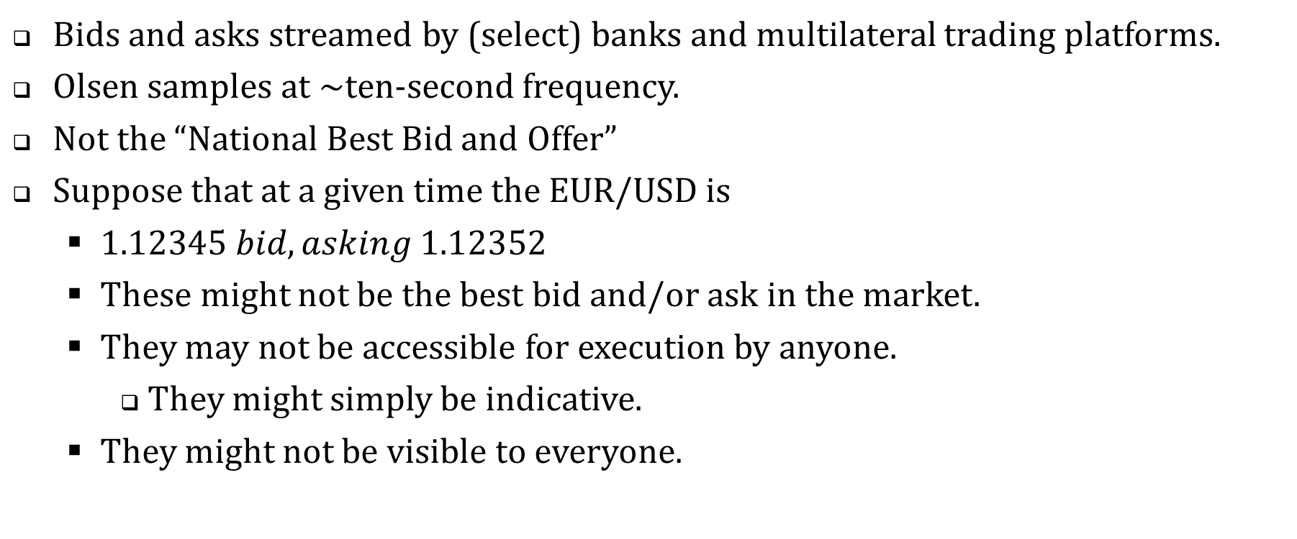
Market prices: bids and asks from Olsen Data
Bids and asks streamed by (select) banks and multilateral trading platforms.
Olsen samples at ~ten-second frequency.
Not the “National Best Bid and Offer”
Suppose that at a given time the EUR/USD is
$1.12345 bid, asking 1.12352$
These might not be the best bid and/or ask in the market.
They may not be accessible for execution by anyone.
They might simply be indicative.
They might not be visible to everyone.

Slide 21
Reconciliation: Do Olsen and CLS agree?
65%-70% of spot settlements can be matched to Olsen quotes in the prior 10 seconds.
80%-90% … in the prior 60 seconds.
Questions?

Slide 22
Centrality and trading profits

Slide 23
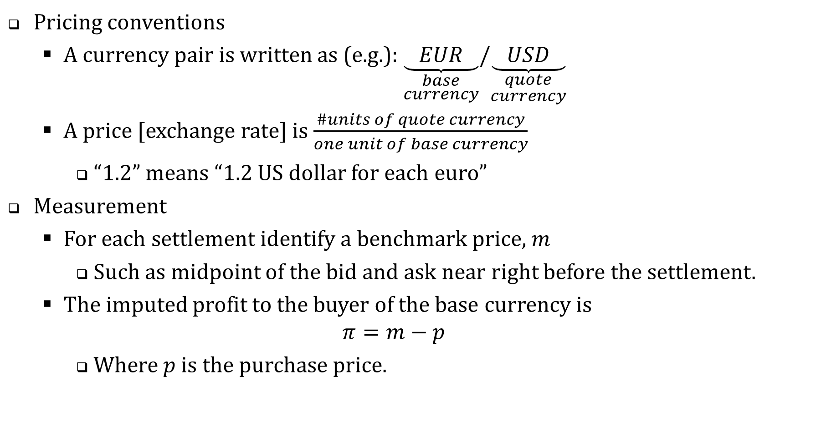
Pricing conventions
A currency pair is written as (e.g.): $\underset{\begin{aligned}base \\ currency\end{aligned}}{\underbrace{ EUR }}/\underset{\begin{aligned}quote \\ currency\end{aligned}}{\underbrace{ USD }}$
A price [exchange rate] is $\frac{\#units of quote currency}{one unit of base currency}$
“1.2” means “1.2 US dollar for each euro”
Measurement
For each settlement identify a benchmark price, $m$
Such as midpoint of the bid and ask near right before the settlement.
The imputed profit to the buyer of the base currency is $π=m−p$
Where $p$ is the purchase price.

Slide 24
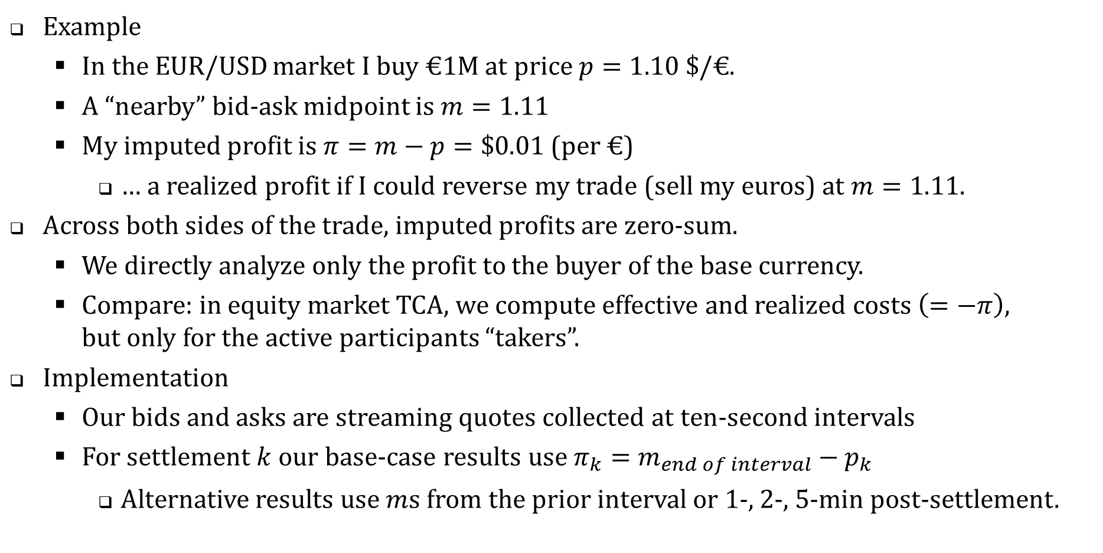
Example
In the EUR/USD market I buy €1M at price $p=1.10 \$/\text{€}$.
A “nearby” bid-ask midpoint is $m=1.11$
My imputed profit is $π=m−p=\$0.01$ (per €)
… a realized profit if I could reverse my trade (sell my euros) at $m=1.11$.
Across both sides of the trade, imputed profits are zero-sum.
We directly analyze only the profit to the buyer of the base currency.
Compare: in equity market TCA, we compute effective and realized costs $\left(=−π\right)$, but only for the active participants “takers”.
Implementation
Our bids and asks are streaming quotes collected at ten-second intervals
For settlement $k$ our base-case results use $π_{k}=m_{end of interval}−p_{k}$
Alternative results use $m$s from the prior interval or 1-, 2-, 5-min post-settlement.

Slide 25
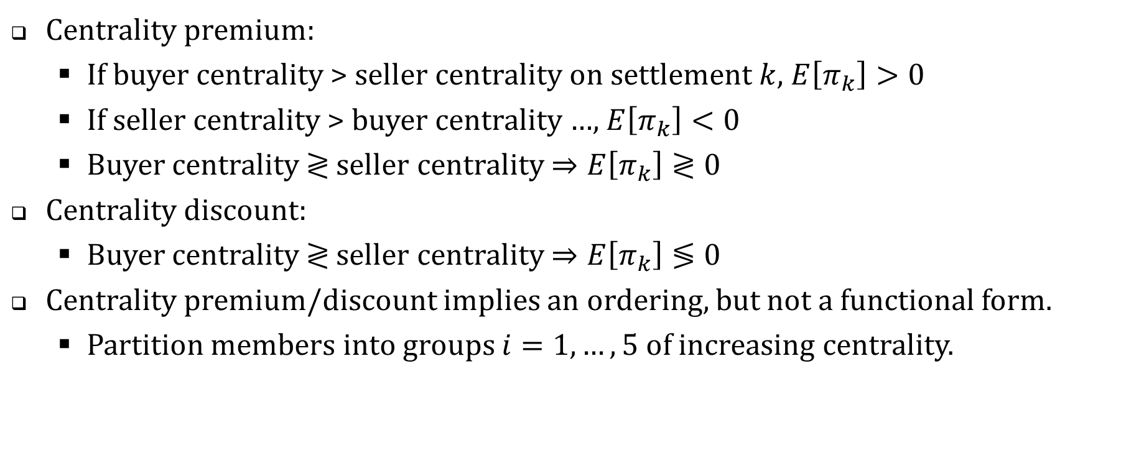
How does $π_{k}$ depend on the buyer’s and seller’s centralities?
Centrality premium:
If buyer centrality > seller centrality on settlement $k$, $E\left[π_{k}\right]>0$
If seller centrality > buyer centrality …, $E\left[π_{k}\right]<0$
Buyer centrality $≷$ seller centrality $⇒E\left[π_{k}\right]≷0$
Centrality discount:
Buyer centrality $≷$ seller centrality $⇒E\left[π_{k}\right]≶0$
Centrality premium/discount implies an ordering, but not a functional form.
Partition members into groups $i=1,…,5$ of increasing centrality.

Slide 26
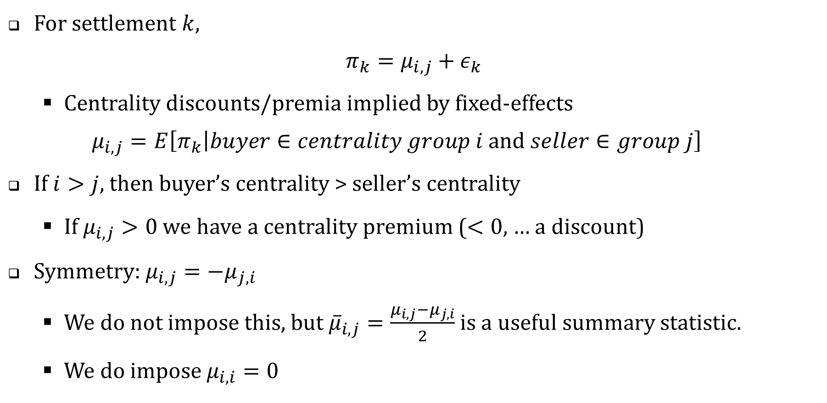
Econometric specification: a linear mixed effects model
For settlement $k$, $π_{k}=μ_{i,j}+ε_{k}$
Centrality discounts/premia implied by fixed-effects $μ_{i,j}=E\left[π_{k}\left|buyer∈centrality group i and seller∈group j\right.\right]$
If $i>j$, then buyer’s centrality > seller’s centrality
If $μ_{i,j}>0$ we have a centrality premium ($<0$, … a discount)
Symmetry: $μ_{i,j}=−μ_{j,i}$
We do not impose this, but ${\overline{μ}}_{i,j}=\frac{μ_{i,j}−μ_{j,i}}{2}$ is a useful summary statistic.
We do impose $μ_{i,i}=0$

Slide 27
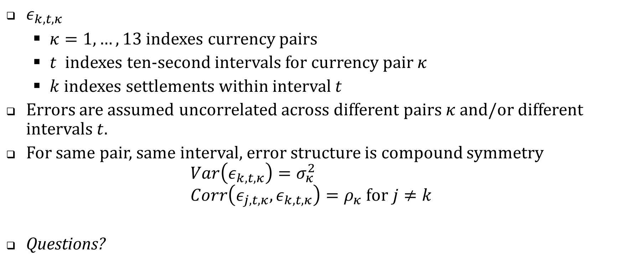
Error specification
$ε_{k,t,κ}$
$κ=1,…,13$ indexes currency pairs
$t$ indexes ten-second intervals for currency pair $κ$
$k$ indexes settlements within interval $t$
Errors are assumed uncorrelated across different pairs $κ$ and/or different intervals $t$.
For same pair, same interval, error structure is compound symmetry $Var\left(ε_{k,t,κ}\right)=σ_{κ}^{2}$ $Corr\left(ε_{j,t,κ},ε_{k,t,κ}\right)=ρ_{κ} for j≠k$
Questions?

Slide 28
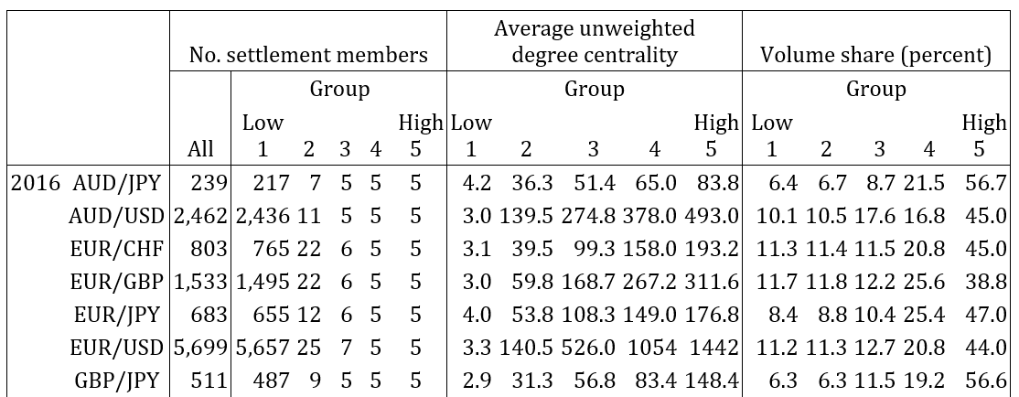
Table 6. Degree centrality groups: descriptive statistics

Slide 29
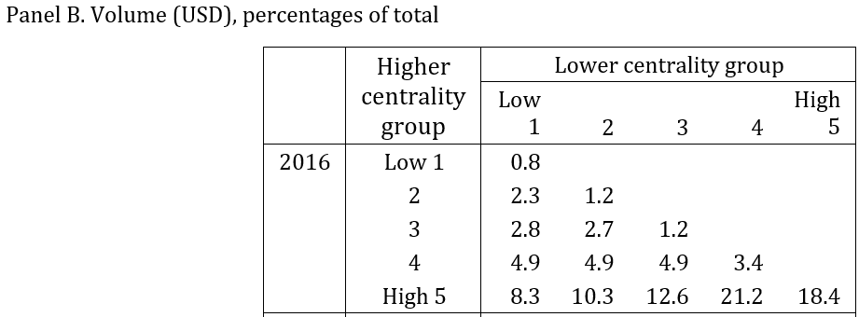
Table 7. Settlement flows between centrality groups

Slide 30
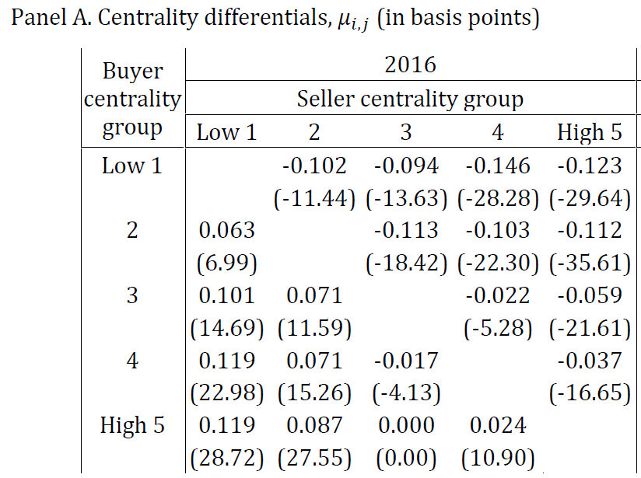
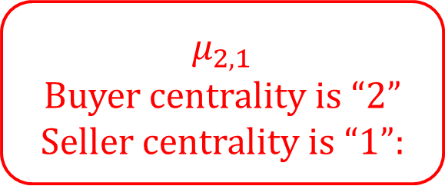
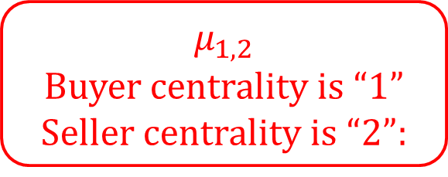
Table 8. Centrality fixed effect estimates (pooled over all currency pairs), basis pts
$μ_{1,2}$ Buyer centrality is “1” Seller centrality is “2”:
$μ_{2,1}$ Buyer centrality is “2” Seller centrality is “1”:

Slide 31
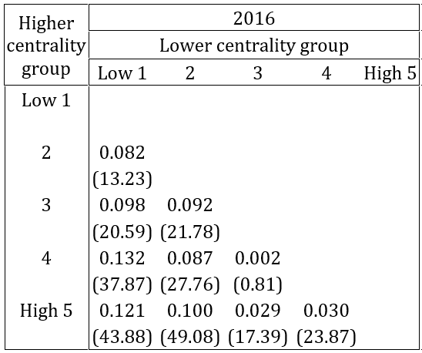

Table 8. Panel B. Centrality differentials averaged across buyers and sellers, ${\overline{μ}}_{i,j}={\left(μ_{i,j}−μ_{j,i}\right)}/2 for i>j$ (in basis points)
Given $i$, ${\overline{μ}}_{i,j}$ is generally decreasing in $j$.
Given $j$, ${\overline{μ}}_{i,j}$ is generally increasing in $i$.

Slide 32
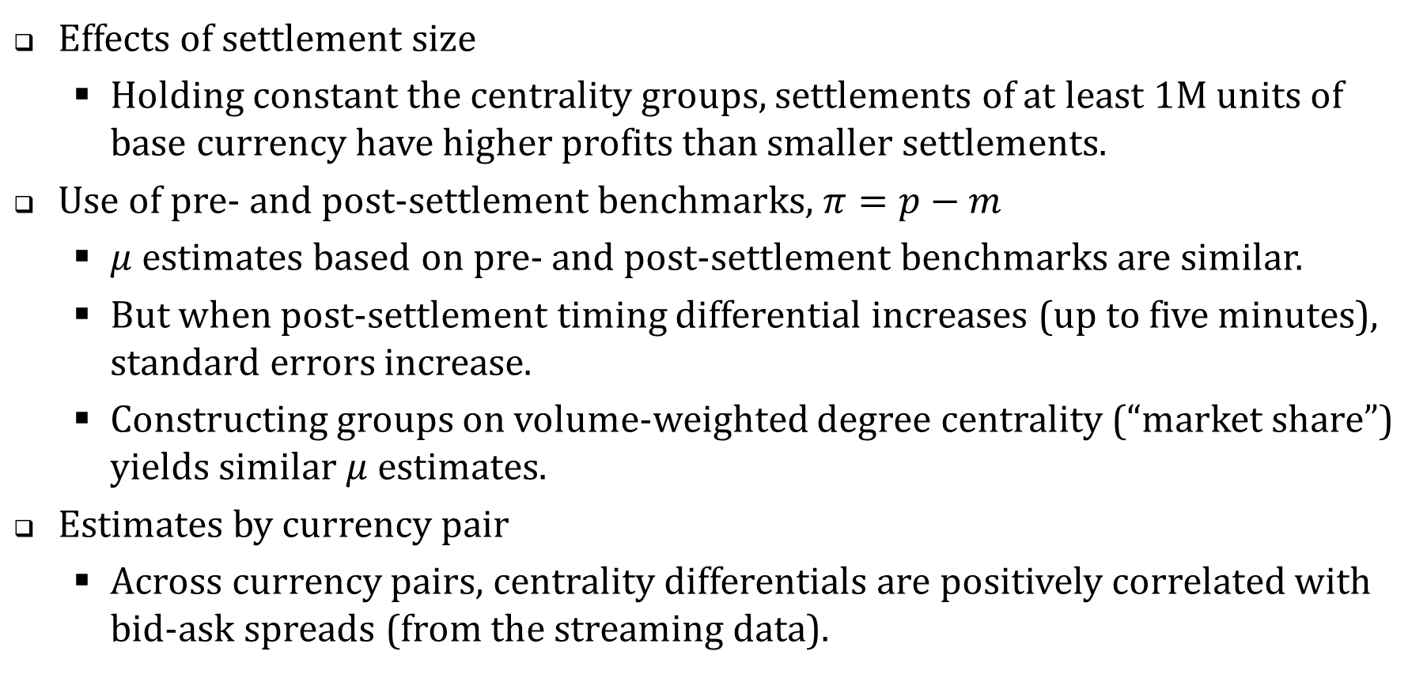
Refinements and robustness checks
Effects of settlement size
Holding constant the centrality groups, settlements of at least 1M units of base currency have higher profits than smaller settlements.
Use of pre- and post-settlement benchmarks, $π=p−m$
$μ$ estimates based on pre- and post-settlement benchmarks are similar.
But when post-settlement timing differential increases (up to five minutes), standard errors increase.
Constructing groups on volume-weighted degree centrality (“market share”) yields similar $μ$ estimates.
Estimates by currency pair
Across currency pairs, centrality differentials are positively correlated with bid-ask spreads (from the streaming data).

Slide 33
Centrality premia and information in flows
On average, central agents earn profits in trades with non-central counterparties.
Are they exploiting market power? Being compensated for a differentiated service (like speed)?
Are the centrality premia compensation for adverse selection?
Traders might not be independent. Orders might have correlated directions.
Is aggregate non-central order flow correlated with price changes?
Can relative centrality be used to “sign” the order flow?

Slide 34
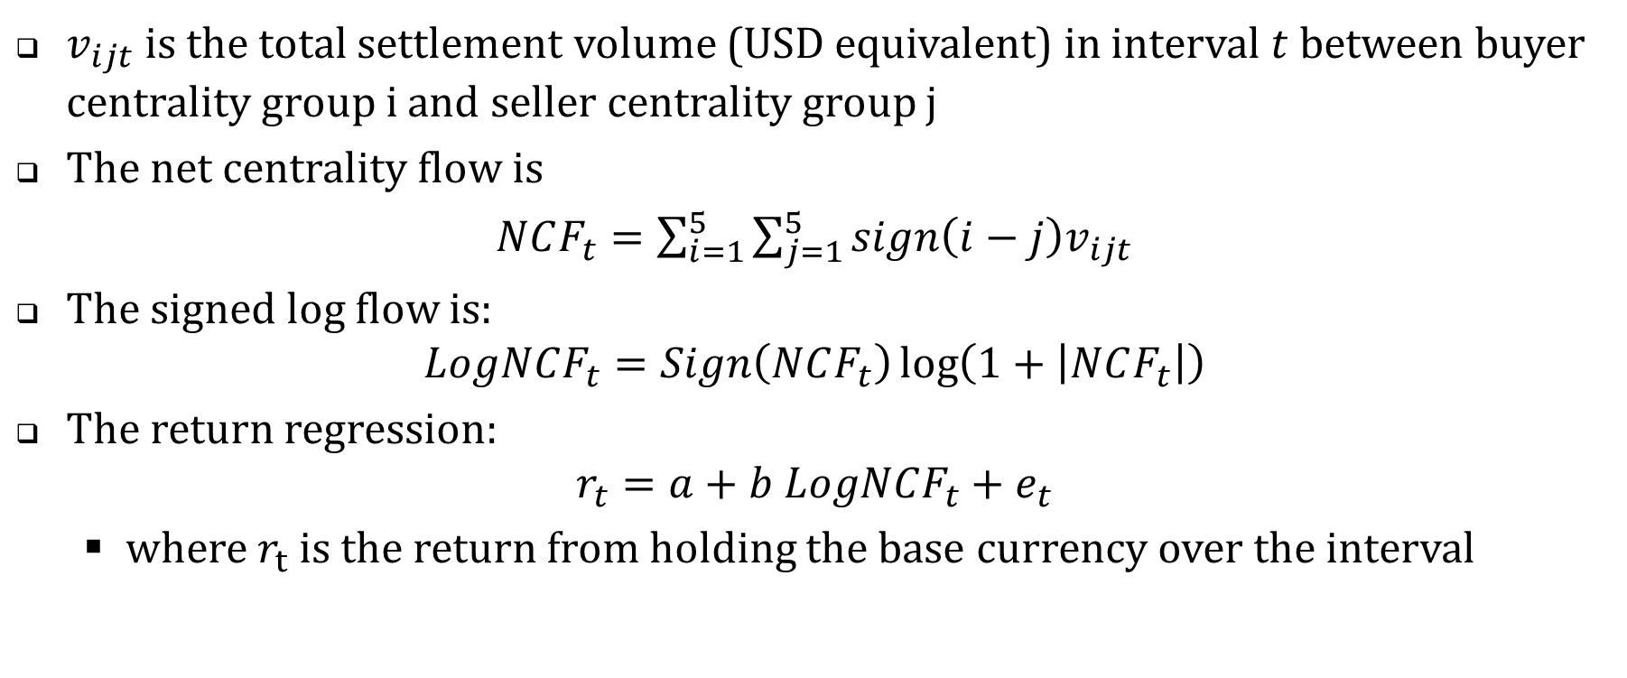
The return analysis
$v_{ijt}$ is the total settlement volume (USD equivalent) in interval $t$ between buyer centrality group i and seller centrality group j
The net centrality flow is
$NCF_{t}=\sum_{i=1}^{5}{\sum_{j=1}^{5}{{sign\left(i−j\right)v}_{ijt}}}$
The signed log flow is: $LogNCF_{t}=Sign\left(NCF_{t}\right)\log\left(1+\left|NCF_{t}\right|\right)$
The return regression: $r_{t}=a+b LogNCF_{t}+e_{t}$
where $r_{t}$ is the return from holding the base currency over the interval

Slide 35
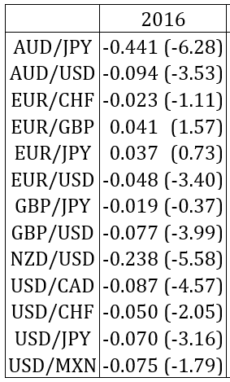
Table 15. Central flows and returns Estimates of $b$ in $r_{t}=a+b LogNCF_{t}+e_{t}$
The central agents are buying during price declines and selling into rising markets.

Slide 36
Summary
The settlement network has many players, likely to include traditional customers and dealers.
The pattern of FX settlements suggests high concentration of activity in large central agents.
Central agents achieve better terms of trade with non-central counterparties.
This is consistent with central agents’ possession of bargaining power.
Central agents are also more exposed to adverse price changes due to commonality in order flows

Slide 37
(Hasbrouck and Levich, 2019) Figure 2. EUR/USD, April 17, 2013

Slide 38
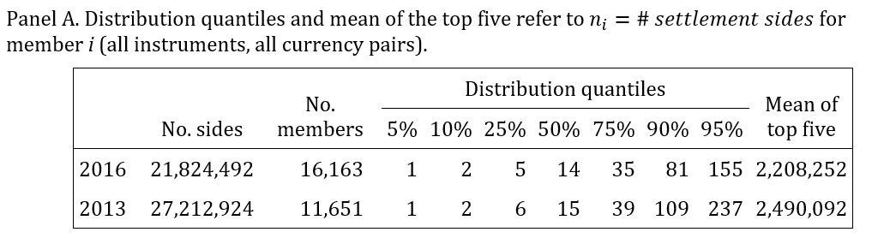
There are many settlement members, but activity is concentrated.
Each trade/settlement has two participants (sides).
Table 1. Distribution of settlement sides per member

Slide 39
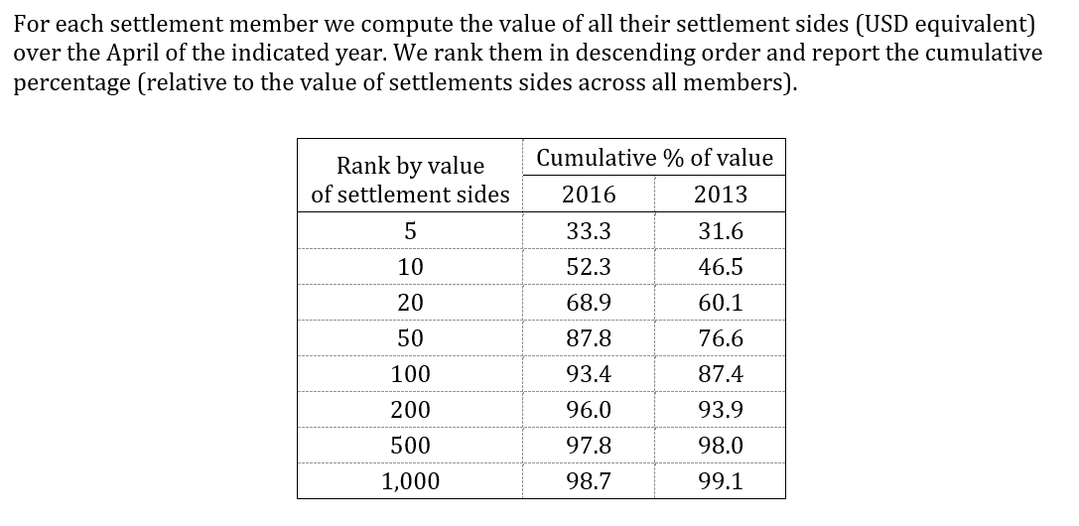
Table 2. Settlement activity by value (all instruments, all currencies)

Slide 40
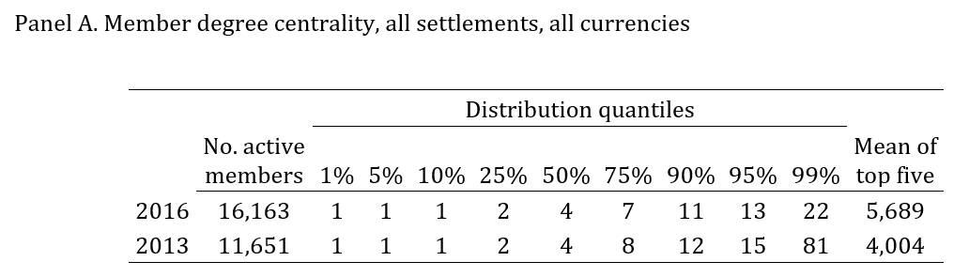
Table 3. Distribution of degree centrality

Slide 41
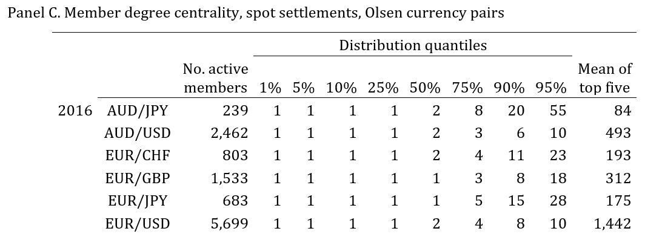

Slide 42
Shortest paths
Pick a pair of nodes: 2 and 7
There are many paths between them.
The shortest path is 2→G→7, with length 2.
Consider all possible pairs of nodes.
Determine the shortest path.
Construct the distribution of shortest-path lengths.

Slide 43
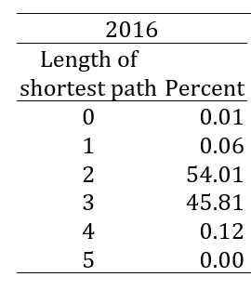
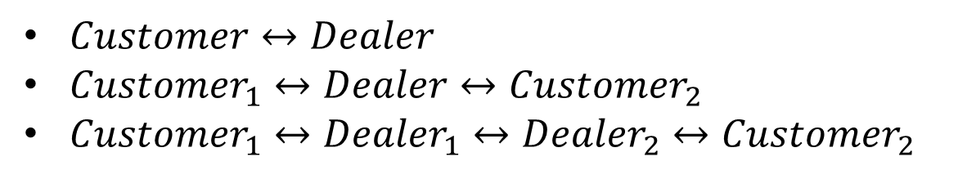
Table 4. Distribution of shortest paths
$Customer↔Dealer$
$Customer_{1}↔Dealer↔Customer_{2}$
$Customer_{1}↔Dealer_{1}↔Dealer_{2}↔Customer_{2}$

Slide 44
Table 6. Degree centrality groups: descriptive statistics

Slide 45
Table 7. Settlement flows between centrality groups

Slide 46
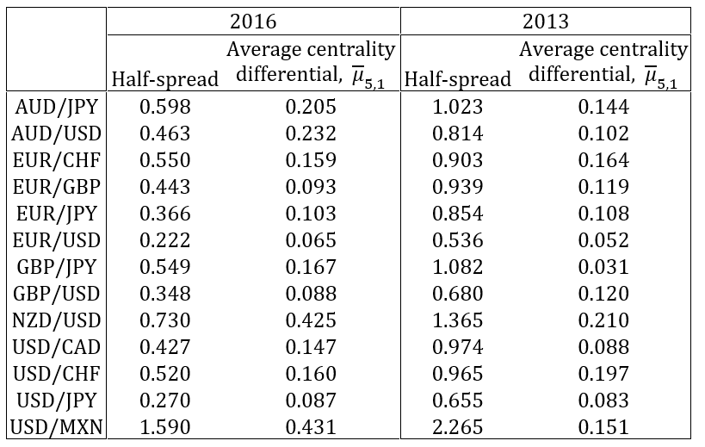
Table 14. Average centrality differentials and bid-ask spreads by currency pair

Slide 47
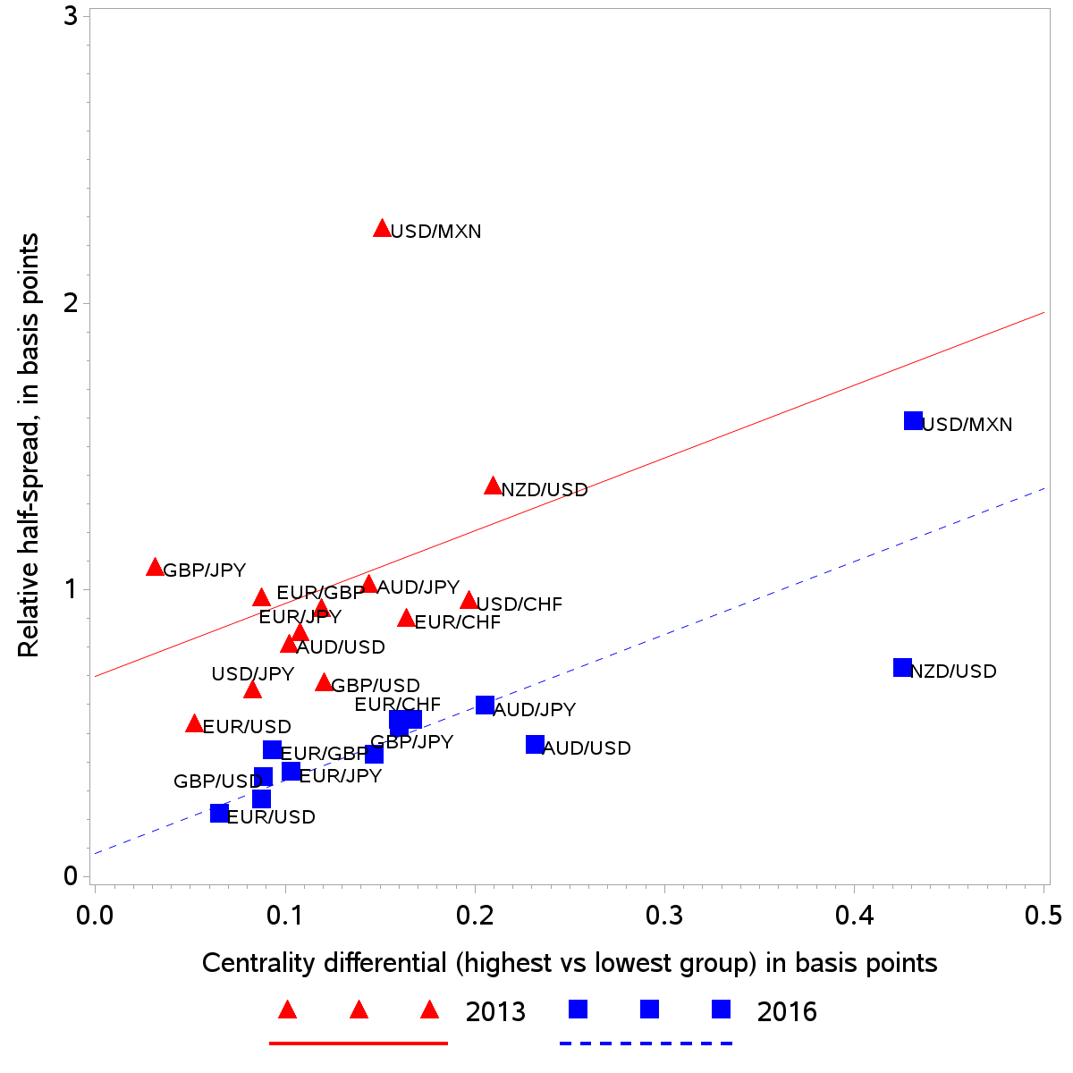
Figure 1. Half-spreads and centrality differentials

